Slide 2
Greedy Algorithms

Slide 3
Motivation
Greedy is an algorithmic paradigm that builds up a solution piece by piece, always choosing the next piece that offers the most obvious and immediate benefit.
So the problems where choosing locally optimal also leads to global solution are best fit for Greedy.

Slide 4
Activity Selection Problem
Let's consider that you have n activities with their start and finish times.
The objective is to find solution set having maximum number of non-conflicting activities that can be executed in a single time frame.
Assuming that only one person or machine is available for execution.
Two activities, say i and j, are said to be non-conflicting
if si >= fj or sj >= fi where si and sj denote the starting time of activities i and j respectively. and fi and fj refer to the finishing time of the activities i and j respectively.

Slide 5
Greedy approach can be used to find the solution since we want to maximize the count of activities that can be executed.
This approach will greedily choose an activity with earliest finish time at every step, thus yielding an optimal solution.

Slide 6
Input Data for the Algorithm:
act[] array containing all the activities.
s[] array containing the starting time of all the activities.
f[] array containing the finishing time of all the activities.
Ouput Data from the Algorithm:
sol[] array refering to the solution set containing the maximum number of non-conflicting activities.

Slide 7
Algorithm
Step 1: Sort the given activities in ascending order according to their finishing time.
Step 2: Select the first activity from sorted array act[] and add it to sol[] array.
Step 3: Repeat steps 4 and 5 for the remaining activities in act[].
Step 4: If the start time of the currently selected activity is greater than or equal to the finish time of previously selected activity, then add it to the sol[] array.
Step 5: Select the next activity in act[] array.
Step 6: Print the sol[] array.

Slide 8
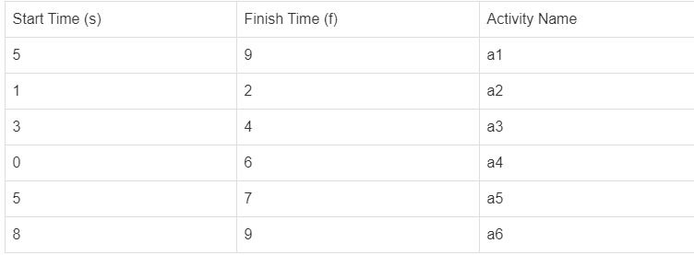
Activity Selection Problem Example

Slide 9
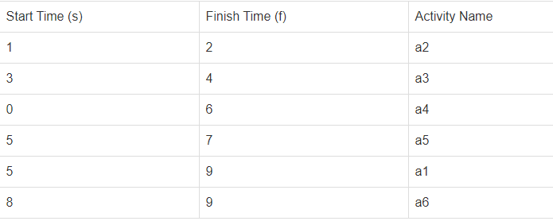
Step 1: Sort the given activities in ascending order according to their finishing time.
The table after we have sorted it:

Slide 10
Step 2: Select the first activity from sorted array act[] and add it to the sol[] array, thus sol = {a2}.
Select activity a3. Since the start time of a3 is greater than the finish time of a2 (i.e. s(a3) > f(a2)), we add a3 to the solution set. Thus sol = {a2, a3}.
Select a4. Since s(a4) < f(a3), it is not added to the solution set.
Select a5. Since s(a5) > f(a3), a5 gets added to solution set. Thus sol = {a2, a3, a5}

Slide 11
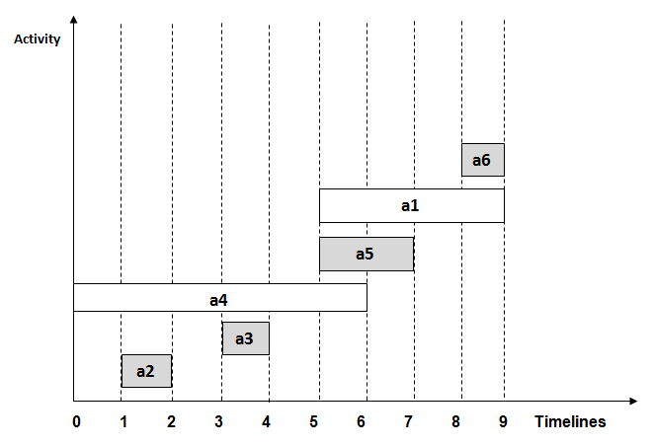
Select a1. Since s(a1) < f(a5), a1 is not added to the solution set.
Select a6. a6 is added to the solution set since s(a6) > f(a5). Thus sol = {a2, a3, a5, a6}.

Slide 12
ACTIVITY-SELECTION(a, s, f)
A = [a[1]]
k = 1
for i in 2 to a.length
if s[i] >= f[k]
A.append(a[i])
k=i
return A

Slide 13
The complexity of this problem is O(n log n) when the list is not sorted.
When the sorted list is provided the complexity will be O(n).

Slide 14
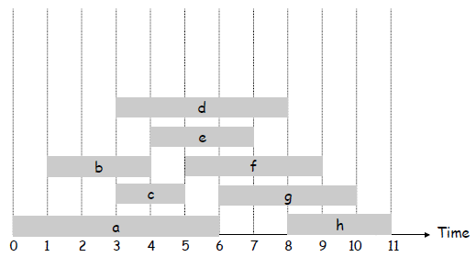
Interval Scheduling

Slide 15
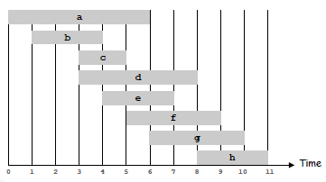
Interval Scheduling
Schedule as many non-overlapping tasks as possible in given timeframe
Interval scheduling.
Job j starts at s_{j} and finishes at f_{j}.
Two jobs compatible if they don't overlap.
Goal: find maximum subset of mutually compatible jobs.

Slide 16
Greedy Algorithm
Greedy Template: Consider jobs in some order. Take each job provided it's compatible with the ones already taken.
[Earliest start time] Consider jobs in ascending order of start time s_{j}.
[Earliest finish time] Consider jobs in ascending order of finish time f_{j}.
[Shortest interval] Consider jobs in ascending order of interval length f_{j} - s_{j}.
[Fewest conflicts] For each job, count the number of conflicting jobs c_{j}. Schedule in ascending order of conflicts c_{j}.

Slide 17
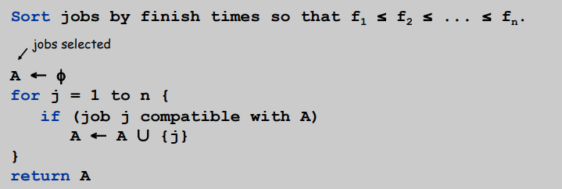
Algorithm
Implementation. O(n log n).
Remember job j* that was added last to A.
Job j is compatible with A if s_{j} ≥ f_{j*}.

Slide 18
Interval Partitioning
Find minimum number of classrooms to schedule all lectures so that no two occur at the same time in the same room.

Slide 19
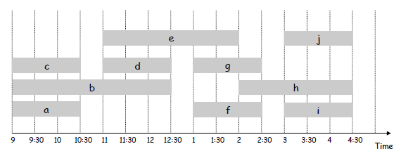
Interval Partitioning
Interval partitioning.
Lecture j starts at sj and finishes at f_{j}.
Goal: find minimum number of classrooms to schedule all lectures so that no two occur at the same time in the same room.
Ex: This schedule uses 4 classrooms to schedule 10 lectures.

Slide 20
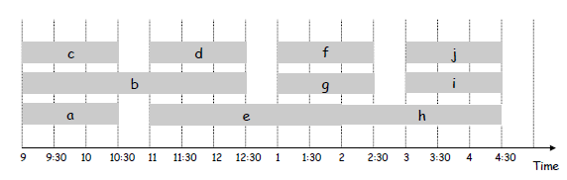
Interval Partitioning
Interval partitioning.
Lecture j starts at sj and finishes at f_{j}.
Goal: find minimum number of classrooms to schedule all lectures so that no two occur at the same time in the same room.
Ex: This schedule uses only 3.

Slide 21
The depth of a set of open intervals is the maximum number that contain any given time.
Number of classrooms needed ≥ depth.

Slide 22
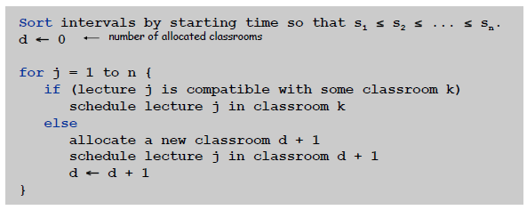
Algorithm
Consider lectures in increasing order of start time: assign lecture to any compatible classroom.
Implementation. O(n log n).
For each classroom k, maintain the finish time of the last job added.
Keep the classrooms in a priority queue.

Slide 23
Knapsack Problem- Fractional
Given a set of items, each with a weight and a value, determine a subset of items to include in a collection so that the total weight is less than or equal to a given limit and the total value is as large as possible.
The knapsack problem is in combinatorial optimization problem.

Slide 24
Fractional Knapsack
Object (i) | 1 | 2 | 3 | 4 | 5 | 6 | 7
Profit (P) | 10 | 5 | 15 | 7 | 6 | 18 | 3
Weights(W) | 2 | 3 | 5 | 7 | 1 | 4 | 1
No. of Objects (n)=7
Capacity (M)=15

Slide 25
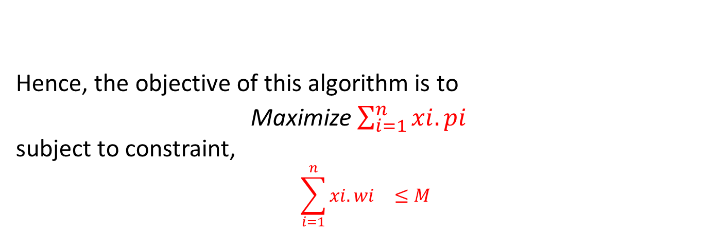
Fractional Knapsack
Items can be broken into smaller pieces, hence the one can select fractions of items.
According to the problem statement,
There are n items in the Set
Weight of i^{th} item w_{i} >0
Profit for i^{th} item p_{i} >0 and
Capacity of the Knapsack is M
Hence, the objective of this algorithm is to
Maximize $\sum_{i=1}^{n}{{xi.pi}^{}}$
subject to constraint,
$$\sum_{i=1}^{n}{{xi.wi}^{}≤M}$$
The i^{th} item contributes the weight x_{i} .w_{i} to the total weight in the knapsack and profit x_{i} .p_{i} to the total profit.

Slide 26
Fractional Knapsack
Algorithm fractionalKnapsack(S, M)
Input: set S of n items with profit p_{i}
and weight w_{i}; max. weight M
Output: amount x_{i} of each item i to
maximize profit/ weight at most M
for each item i in S
x_{i} ← 0
v_{i} ← p_{i} / w_{i} {value}
W ← 0 {total weight}
while W < M
remove item i with highest v_{i}
x_{i} ← min{w_{i} , M - W}
W← W + min{w_{i} , M - W}
Algorithm: Greedy-Fractional-Knapsack (S, M)
for i = 1 to n
x[i] = 0
v[i] = p[i]/w[i]
weight = 0 #total weight
Sort the Array w & p according to v non ascending order
for i = 1 to n
if weight + w[i] ≤ M then
x[i] = 1
weight = weight + w[i]
else
x[i] = (M - weight) / w[i]
weight = M
break
return x

Slide 27
Fractional Knapsack
Item | B | A | C | D
Profit | 100 | 280 | 120 | 120
Weight | 10 | 40 | 20 | 24
M=60

Slide 28
Item | Weight | Profit
1 | 5 | 30
2 | 10 | 40
3 | 15 | 45
4 | 22 | 77
5 | 25 | 90
M=60

Slide 29
Applications
In many cases of resource allocation along with some constraint, the problem can be derived in a similar way of Knapsack problem. Following is a set of example.
Finding the least wasteful way to cut raw materials
portfolio optimization
Cutting stock problems

Slide 30
Spanning Tree
What is Spanning Tree?

Slide 31
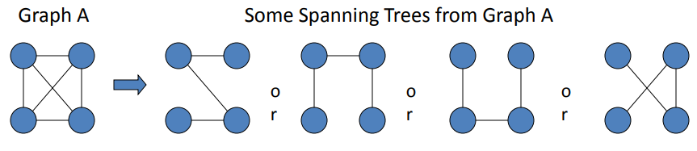
Spanning Trees
A spanning tree of a graph is just a subgraph that contains all the vertices and is a tree.
A graph may have many spanning trees.

Slide 32
Complete Graph
All 16 of its Spanning Trees

Slide 33
Problem: Laying Telephone Wire
Central office

Slide 34
Wiring: Naïve Approach
Central office
Expensive!

Slide 35
Wiring: Better Approach
Central office
Minimize the total length of wire connecting the customers

Slide 36
Minimum Spanning Trees(MST)
The Minimum Spanning Tree for a given graph is the Spanning Tree of minimum cost for that graph.
OR
The Minimum Spanning Tree is a subgraph of an undirected weighted graph G, such that
it is a tree (i.e., it is acyclic)
it covers all the vertices V
contains |V| - 1 edges
the total cost associated with tree edges is the minimum among all possible spanning trees
not necessarily unique

Slide 37
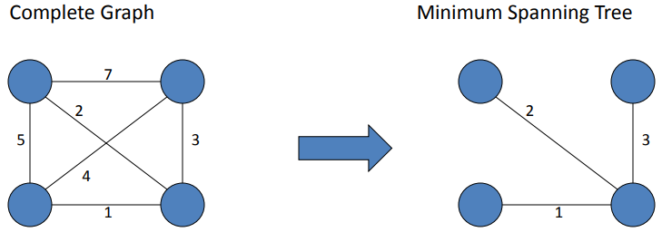
9
b
9
b
a
2
6
a
2
6
d
d
4
5
4
5
5
4
5
4
5
e
5
e
c
c

Slide 38
Algorithms for Minimum Spanning Tree(MST)
Kruskal's Algorithm
Prim's Algorithm

Slide 39
Kruskal’s Algorithm
Initialization
a. Create a set for each vertex v ∈ V
b. Initialize the set of “safe edges” A comprising the MST to the empty set
c. Sort edges by increasing weight
9
b
a
2
6
F = {a}, {b}, {c}, {d}, {e}
A = ∅
E = {(a,d), (c,d), (d,e), (a,c),
(b,e), (c,e), (b,d), (a,b)}
d
4
5
5
4
5
e
c

Slide 40
Kruskal’s Algorithm
9
b
a
2
6
E = {(a,d), (c,d), (d,e), (a,c),
(b,e), (c,e), (b,d), (a,b)}
d
4
5
5
4
5
e
c
Forest
{a}, {b}, {c}, {d}, {e}
{a,d}, {b}, {c}, {e}
{a,d,c}, {b}, {e}
{a,d,c,e}, {b}
{a,d,c,e,b}
A
∅
{(a,d)}
{(a,d), (c,d)}
{(a,d), (c,d), (d,e)}
{(a,d), (c,d), (d,e), (b,e)}

Slide 41
Graph
B
4
C
4
2
1
A
4
E
1
F
D
2
3
10
G
5
5
6
3
4
I
H
2
3
J

Slide 42
A
4
B
A
1
D
B
4
C
B
4
D
B
4
C
B
10
J
C
2
E
4
2
1
C
1
F
D
5
H
A
4
E
1
F
2
D
6
J
E
2
G
D
3
10
G
5
F
3
G
F
5
I
5
6
3
4
I
G
3
I
G
4
J
H
2
3
J
H
2
J
I
3
J

Slide 43
Sort Edges
(in reality they are placed in a priority queue - not sorted - but sorting them makes the algorithm easier to visualize)
1
1
A
D
C
F
C
2
E
E
2
G
B
4
C
H
2
J
F
3
G
4
2
1
G
3
I
I
3
J
A
4
E
1
F
2
A
4
B
B
4
D
D
3
10
G
5
B
4
C
G
4
J
5
6
3
4
I
F
5
I
D
5
H
H
2
3
J
D
6
J
B
10
J

Slide 44
Add Edge
1
1
A
D
C
F
C
2
E
E
2
G
B
4
C
H
2
J
F
3
G
4
2
1
G
3
I
I
3
J
A
4
E
1
F
2
A
4
B
B
4
D
D
3
10
G
5
B
4
C
G
4
J
5
6
3
4
I
F
5
I
D
5
H
H
2
3
J
D
6
J
B
10
J

Slide 45
Add Edge
1
1
A
D
C
F
C
2
E
E
2
G
B
4
C
H
2
J
F
3
G
4
2
1
G
3
I
I
3
J
A
4
E
1
F
2
A
4
B
B
4
D
D
3
10
G
5
B
4
C
G
4
J
5
6
3
4
I
F
5
I
D
5
H
H
2
3
J
D
6
J
B
10
J

Slide 46
Add Edge
1
1
A
D
C
F
C
2
E
E
2
G
B
4
C
H
2
J
F
3
G
4
2
1
G
3
I
I
3
J
A
4
E
1
F
2
A
4
B
B
4
D
D
3
10
G
5
B
4
C
G
4
J
5
6
3
4
I
F
5
I
D
5
H
H
2
3
J
D
6
J
B
10
J

Slide 47
Add Edge
1
1
A
D
C
F
C
2
E
E
2
G
B
4
C
H
2
J
F
3
G
4
2
1
G
3
I
I
3
J
A
4
E
1
F
2
A
4
B
B
4
D
D
3
10
G
5
B
4
C
G
4
J
5
6
3
4
I
F
5
I
D
5
H
H
2
3
J
D
6
J
B
10
J

Slide 48
Add Edge
1
1
A
D
C
F
C
2
E
E
2
G
B
4
C
H
2
J
F
3
G
4
2
1
G
3
I
I
3
J
A
4
E
1
F
2
A
4
B
B
4
D
D
3
10
G
5
B
4
C
G
4
J
5
6
3
4
I
F
5
I
D
5
H
H
2
3
J
D
6
J
B
10
J

Slide 49
Cycle
Don’t Add Edge
1
1
A
D
C
F
C
2
E
E
2
G
B
4
C
H
2
J
F
3
G
4
2
1
G
3
I
I
3
J
A
4
E
1
F
2
A
4
B
B
4
D
D
3
10
G
5
B
4
C
G
4
J
5
6
3
4
I
F
5
I
D
5
H
H
2
3
J
D
6
J
B
10
J

Slide 50
Add Edge
1
1
A
D
C
F
C
2
E
E
2
G
B
4
C
H
2
J
F
3
G
4
2
1
G
3
I
I
3
J
A
4
E
1
F
2
A
4
B
B
4
D
D
3
10
G
5
B
4
C
G
4
J
5
6
3
4
I
F
5
I
D
5
H
H
2
3
J
D
6
J
B
10
J

Slide 51
Add Edge
1
1
A
D
C
F
C
2
E
E
2
G
B
4
C
H
2
J
F
3
G
4
2
1
G
3
I
I
3
J
A
4
E
1
F
2
A
4
B
B
4
D
D
3
10
G
5
B
4
C
G
4
J
5
6
3
4
I
F
5
I
D
5
H
H
2
3
J
D
6
J
B
10
J

Slide 52
Add Edge
1
1
A
D
C
F
C
2
E
E
2
G
B
4
C
H
2
J
F
3
G
4
2
1
G
3
I
I
3
J
A
4
E
1
F
2
A
4
B
B
4
D
D
3
10
G
5
B
4
C
G
4
J
5
6
3
4
I
F
5
I
D
5
H
H
2
3
J
D
6
J
B
10
J

Slide 53
Cycle
Don’t Add Edge
1
1
A
D
C
F
C
2
E
E
2
G
B
4
C
H
2
J
F
3
G
4
2
1
G
3
I
I
3
J
A
4
E
1
F
2
A
4
B
B
4
D
D
3
10
G
5
B
4
C
G
4
J
5
6
3
4
I
F
5
I
D
5
H
H
2
3
J
D
6
J
B
10
J

Slide 54
Add Edge
1
1
A
D
C
F
C
2
E
E
2
G
B
4
C
H
2
J
F
3
G
4
2
1
G
3
I
I
3
J
A
4
E
1
F
2
A
4
B
B
4
D
D
3
10
G
5
B
4
C
G
4
J
5
6
3
4
I
F
5
I
D
5
H
H
2
3
J
D
6
J
B
10
J

Slide 55
Minimum Spanning Tree
Graph
B
4
C
4
B
C
4
4
2
1
2
1
A
E
A
4
1
F
E
F
1
D
2
2
D
3
10
G
G
5
3
5
6
3
4
I
I
H
H
2
3
3
J
2
J

Slide 56
algorithm Kruskal(G)
F:= ∅
for each v ∈ G.V do
MAKE-SET(v)
for each (u, v) in G.E ordered by weight(u, v), increasing do
if FIND-SET(u) ≠ FIND-SET(v) then
F:= F ∪ {(u, v)}
UNION(FIND-SET(u), FIND-SET(v))
return F
Running time bounded by sorting (or findMin)
O(|E|log|E|), or equivalently, O(|E|log|V|)

Slide 57
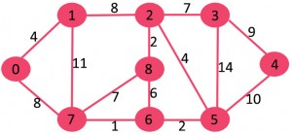

Slide 58
Prim's Algorithm
This algorithm starts with one node. It then, one by one, adds a node that is unconnected to the new graph to the new graph, each time selecting the node whose connecting edge has the smallest weight out of the available nodes’ connecting edges.

Slide 59
Prim’s Algorithm
Initialization
a. Pick a vertex r to be the root
b. Set D(r) = 0, parent(r) = null
c. For all vertices v ∈ V, v ≠ r, set D(v) = ∞
d. Insert all vertices into priority queue P,
using distances as the keys
9
Vertex Parent
e -
b
a
2
6
e
a
b
c
d
d
4
5
0
∞
∞
∞
∞
5
4
5
e
c

Slide 60
Prim’s algorithm
Vertex Parent
e -
b -
c -
d -
e
d
b
c
a
0
∞
∞
∞
∞
9
b
a
2
6
d
4
5
Vertex Parent
e -
b e
c e
d e
5
4
d
b
c
a
5
e
c
4
5
5
∞
The MST initially consists of the vertex e, and we update
the distances and parent for its adjacent vertices

Slide 61
Prim’s algorithm
Vertex Parent
e -
b e
c e
d e
d
b
c
a
4
5
5
∞
9
b
a
2
6
d
4
5
5
4
Vertex Parent
e -
b e
c d
d e
a d
5
e
c
a
c
b
2
4
5

Slide 62
Prim’s algorithm
Vertex Parent
e -
b e
c d
d e
a d
a
c
b
2
4
5
9
b
a
2
6
d
4
5
5
4
5
e
c
Vertex Parent
e -
b e
c d
d e
a d
c
b
4
5

Slide 63
Prim’s algorithm
Vertex Parent
e -
b e
c d
d e
a d
c
b
9
b
4
5
a
2
6
d
4
5
5
4
5
e
Vertex Parent
e -
b e
c d
d e
a d
c
b
5

Slide 64
Prim’s algorithm
Vertex Parent
e -
b e
c d
d e
a d
b
5
9
b
a
2
6
d
4
5
5
4
5
e
c
Vertex Parent
e -
b e
c d
d e
a d
The final minimum spanning tree

Slide 65
Complete Graph
B
4
C
4
2
1
A
4
E
1
F
D
2
3
10
G
5
5
6
3
4
I
H
2
3
J

Slide 66
Old Graph
New Graph
B
4
C
4
B
4
C
2
1
4
2
1
A
4
E
1
F
A
4
E
F
1
D
2
3
10
D
2
3
G
5
10
G
5
5
6
3
5
6
3
4
I
4
H
I
3
H
2
J
2
3
J

Slide 67
Old Graph
New Graph
B
4
C
4
B
4
C
2
1
4
2
1
A
4
E
1
F
A
4
E
F
1
D
2
3
10
D
2
3
G
5
10
G
5
5
6
3
5
6
3
4
I
4
H
I
3
H
2
J
2
3
J

Slide 68
Old Graph
New Graph
B
4
C
4
B
4
C
2
1
4
2
1
A
4
E
1
F
A
4
E
F
1
D
2
3
10
D
2
3
G
5
10
G
5
5
6
3
5
6
3
4
I
4
H
I
3
H
2
J
2
3
J

Slide 69
Old Graph
New Graph
B
4
C
4
B
4
C
2
1
4
2
1
A
4
E
1
F
A
4
E
F
1
D
2
3
10
D
2
3
G
5
10
G
5
5
6
3
5
6
3
4
I
4
H
I
3
H
2
J
2
3
J

Slide 70
Old Graph
New Graph
B
4
C
4
B
4
C
2
1
4
2
1
A
4
E
1
F
A
4
E
F
1
D
2
3
10
D
2
3
G
5
10
G
5
5
6
3
5
6
3
4
I
4
H
I
3
H
2
J
2
3
J

Slide 71
Old Graph
New Graph
B
4
C
4
B
4
C
2
1
4
2
1
A
4
E
1
F
A
4
E
F
1
D
2
3
10
D
2
3
G
5
10
G
5
5
6
3
5
6
3
4
I
4
H
I
3
H
2
J
2
3
J

Slide 72
Old Graph
New Graph
B
4
C
4
B
4
C
2
1
4
2
1
A
4
E
1
F
A
4
E
F
1
D
2
3
10
D
2
3
G
5
10
G
5
5
6
3
5
6
3
4
I
4
H
I
3
H
2
J
2
3
J

Slide 73
Old Graph
New Graph
B
4
C
4
B
4
C
2
1
4
2
1
A
4
E
1
F
A
4
E
F
1
D
2
3
10
D
2
3
G
5
10
G
5
5
6
3
5
6
3
4
I
4
H
I
3
H
2
J
2
3
J

Slide 74
Old Graph
New Graph
B
4
C
4
B
4
C
2
1
4
2
1
A
4
E
1
F
A
4
E
F
1
D
2
3
10
D
2
3
G
5
10
G
5
5
6
3
5
6
3
4
I
4
H
I
3
H
2
J
2
3
J

Slide 75
Old Graph
New Graph
B
4
C
4
B
4
C
2
1
4
2
1
A
4
E
1
F
A
4
E
F
1
D
2
3
10
D
2
3
G
5
10
G
5
5
6
3
5
6
3
4
I
4
H
I
3
H
2
J
2
3
J

Slide 76
Complete Graph
Minimum Spanning Tree
B
4
C
4
B
4
C
2
1
4
2
1
A
4
E
1
F
A
E
F
1
D
2
3
10
D
2
G
5
G
5
6
3
3
4
I
H
I
3
H
2
J
2
3
J

Slide 77
Prim's Algorithm shows how we create two sets of vertices U and V-U. U contains the list of vertices that have been visited and V-U the list of vertices that haven't. One by one, we move vertices from set V-U to set U by connecting the least weight edge.
Algorithm Prims(G)
T = ∅;
U = { 1 };
while (U ≠ V)
let (u, v) be the lowest cost edge such that u ∈ U and v ∈ V - U;
T = T ∪ {(u, v)}
U = U ∪ {v}

Slide 79
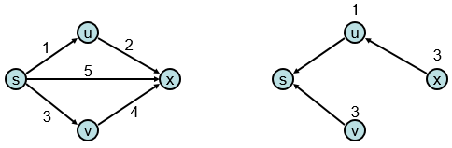
Single-Source Shortest Path Problem
Single-Source Shortest Path Problem - The problem of finding shortest paths from a source vertex v to all other vertices in the graph.
Given a graph and a start vertex s
Determine distance of every vertex from s
Identify shortest paths to each vertex
Express concisely as a “shortest paths tree”
Each vertex has a pointer to a predecessor on shortest path

Slide 80
Dijkstra's Algorithm
Dijkstra's algorithm - is a solution to the single-source shortest path problem in graph theory.
Works on both directed and undirected graphs. However, all edges must have nonnegative weights.
Input: Weighted graph G={E,V} and source vertex v ∈ V, such that all edge weights are nonnegative
Output: Lengths of shortest paths (or the shortest paths themselves) from a given source vertex v ∈ V to all other vertices

Slide 81
Approach
The algorithm computes for each vertex u the distance to u from the start vertex v, that is, the weight of a shortest path between v and u.
The algorithm keeps track of the set of vertices for which the distance has been computed, called the cloud C
Every vertex has a label D associated with it. For any vertex u, D[u] stores an approximation of the distance between v and u. The algorithm will update a D[u] value when it finds a shorter path from v to u.
When a vertex u is added to the cloud, its label D[u] is equal to the actual (final) distance between the starting vertex v and vertex u.

Slide 82
Example: Initialization
Distance(source) = 0
0
∞
Distance (all vertices but source) = ∞
A
2
B
4
1
3
10
∞
C
2
D
2
E
∞
5
8
∞
4
6
F
1
G
∞
∞
Pick vertex in List with minimum distance.

Slide 83
Example: Update neighbors' distance
0
2
A
2
B
4
1
3
10
∞
C
2
D
2
E
∞
5
8
1
4
6
Distance(B) = 2
F
1
G
Distance(D) = 1
∞
∞

Slide 84
Example: Remove vertex with minimum distance
0
2
A
2
B
4
1
3
10
∞
C
2
D
2
E
∞
5
8
1
4
6
F
1
G
∞
∞
Pick vertex in List with minimum distance, i.e., D

Slide 85
Example: Update neighbors
0
2
A
2
B
4
1
3
10
3
C
2
D
2
E
3
5
8
1
4
6
Distance(C) = 1 + 2 = 3 Distance(E) = 1 + 2 = 3 Distance(F) = 1 + 8 = 9 Distance(G) = 1 + 4 = 5
F
1
G
9
5

Slide 86
Example: Continued...
Pick vertex in List with minimum distance (B) and update neighbors
0
2
A
2
B
4
1
3
10
3
C
2
D
2
E
3
5
8
1
4
6
Note : distance(D) not updated since D is already known and distance(E) not updated since it is larger than previously computed
F
1
G
9
5

Slide 87
Example: Continued...
Pick vertex List with minimum distance (E) and update neighbors
0
2
A
2
B
4
1
3
10
3
C
2
D
2
E
3
5
8
1
4
6
F
1
G
No updating
9
5

Slide 88
Example: Continued...
Pick vertex List with minimum distance (C) and update neighbors
0
2
A
2
B
4
1
3
10
3
C
2
D
2
E
3
5
8
1
4
6
Distance(F) = 3 + 5 = 8
F
1
G
8
5

Slide 89
Example: Continued...
Pick vertex List with minimum distance (G) and update neighbors
0
2
A
2
B
4
1
3
10
3
C
2
D
2
E
3
5
8
1
4
6
F
1
G
Previous distance
6
5
Distance(F) = min (8, 5+1) = 6

Slide 90
Example (end)
0
2
A
2
B
4
1
3
10
3
C
2
D
2
E
3
5
8
1
4
6
F
1
G
6
5
Pick vertex not in S with lowest cost (F) and update neighbors

Slide 91
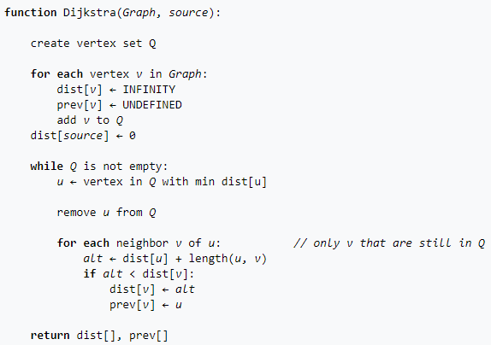

Slide 92
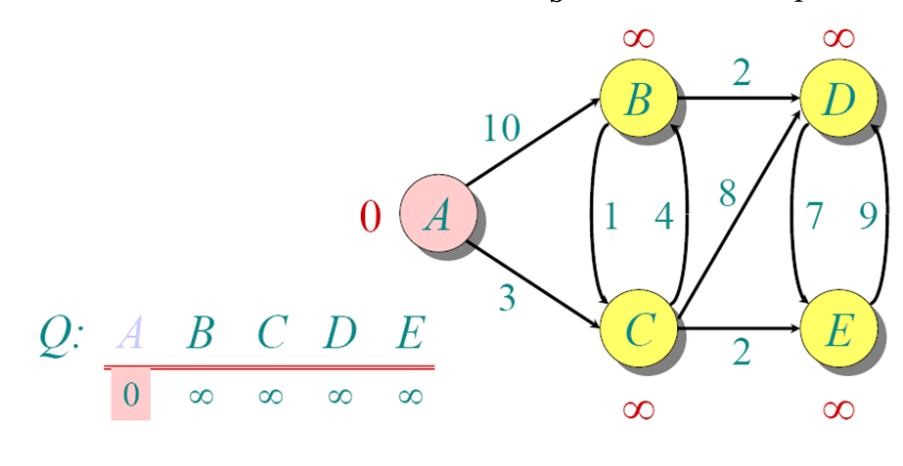
Another Example

Slide 93
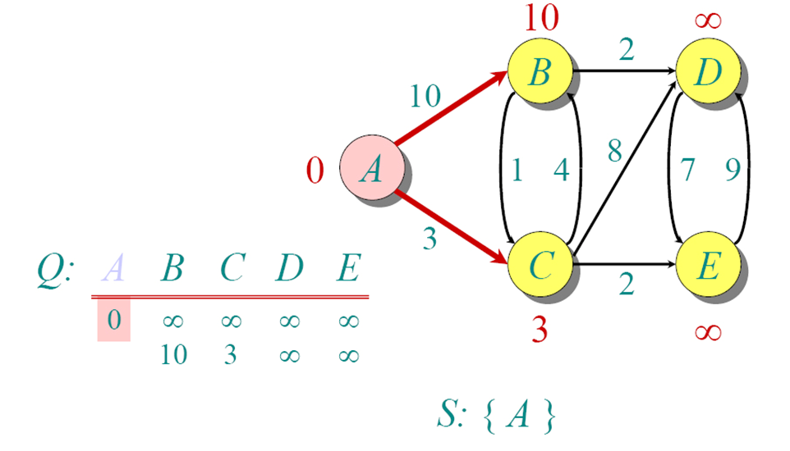
Another Example

Slide 94
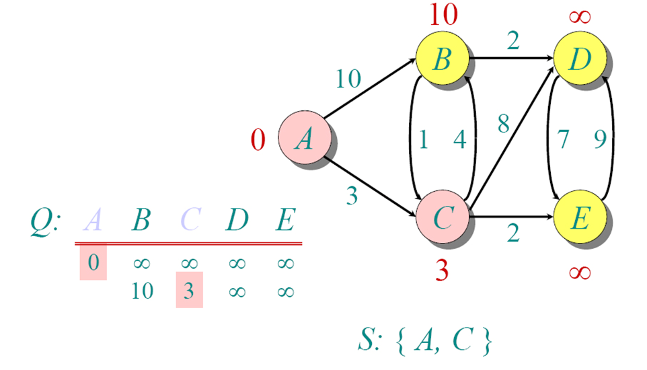
Another Example

Slide 95
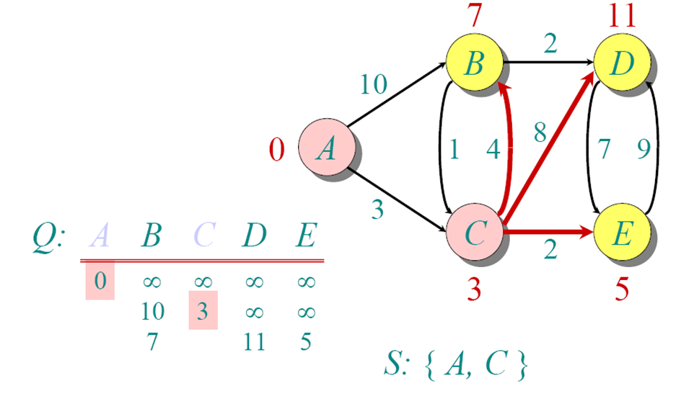
Another Example

Slide 96
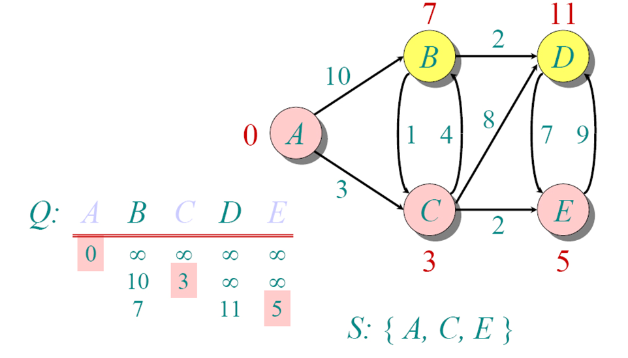
Another Example

Slide 97
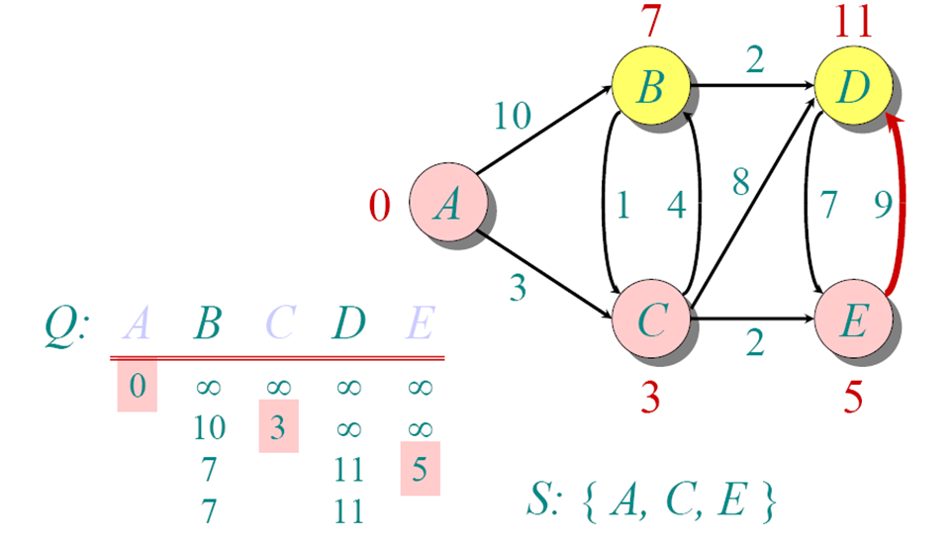
Another Example

Slide 98
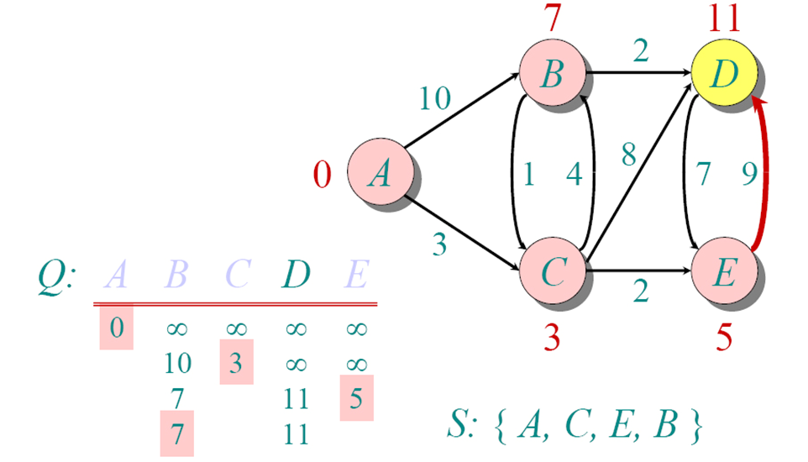
Another Example

Slide 99
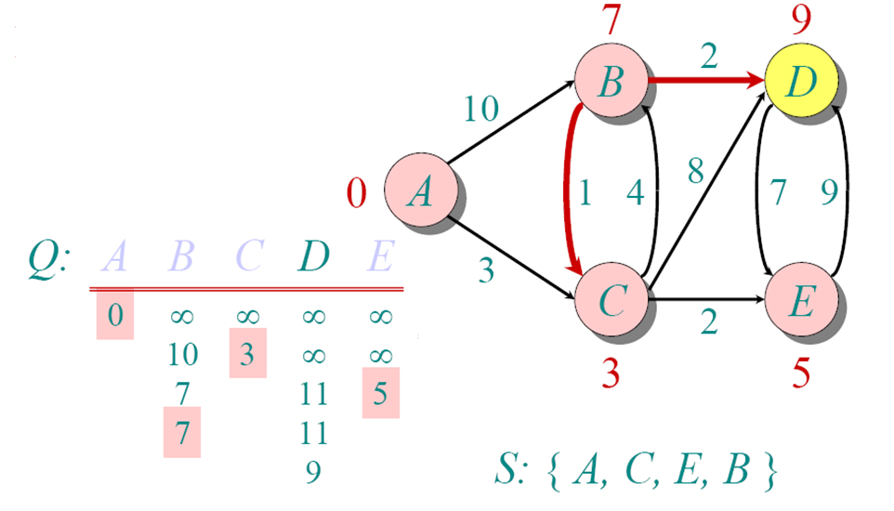
Another Example

Slide 100
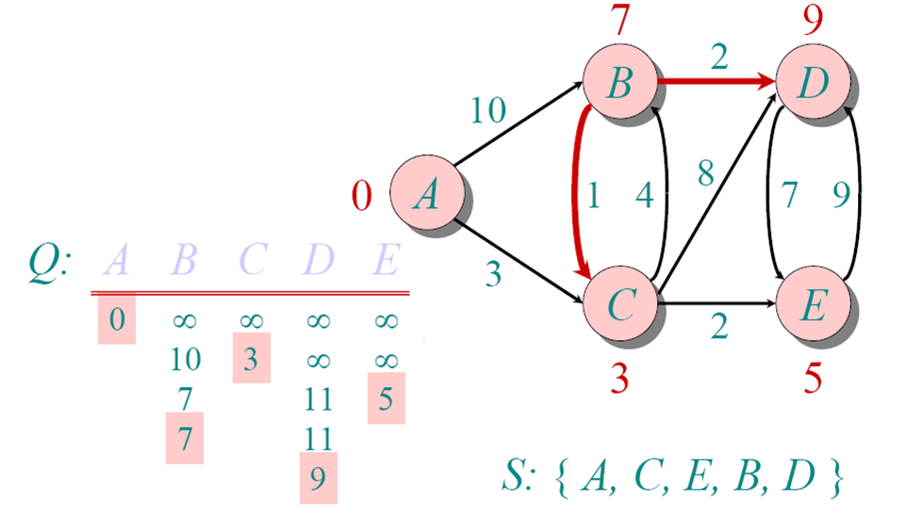
Another Example

Slide 101
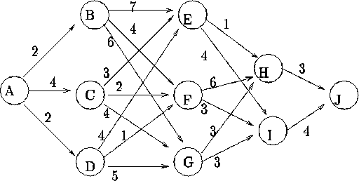

Slide 102
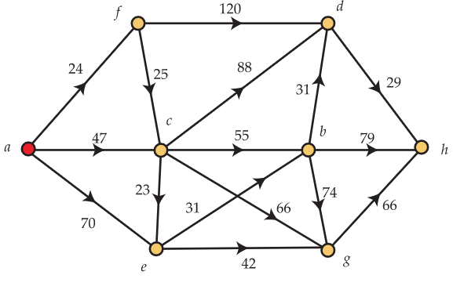

Slide 103
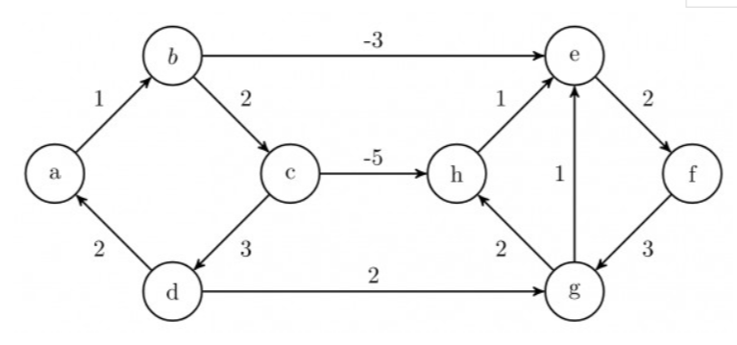

Slide 104
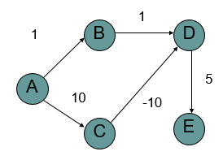
What is the shortest path from A to E?

Slide 105
What about Dijkstra’s …?
1
1
B
D
A
5
10
-10
C
E

Slide 106
What about Dijkstra’s…?
Dijkstra’s algorithm only works for positive edge weights
1
1
B
D
A
5
10
C
E

Slide 107
Bellman-Ford Algorithm for Single Source Shortest Paths
More general than Dijkstra’s algorithm:
Edge-weights can be negative
Detects the existence of negative-weight cycle(s) reachable from s.

Slide 108
Bellman-Ford algorithm
10
How many edges is the shortest path from s to:
S
A
8
1
G
-4
B
A:
2
1
1
-2
C
F
-1
3
E
D
-1

Slide 109
Bellman-Ford algorithm
10
How many edges is the shortest path from s to:
S
A
8
1
G
-4
B
A:
3
2
1
1
-2
C
F
-1
3
E
D
-1

Slide 110
Bellman-Ford algorithm
10
How many edges is the shortest path from s to:
S
A
8
1
G
-4
B
A:
3
2
1
1
-2
B:
F
C
-1
3
E
D
-1

Slide 111
Bellman-Ford algorithm
10
How many edges is the shortest path from s to:
S
A
8
1
G
-4
B
A:
3
2
1
1
-2
B:
5
F
C
-1
3
E
D
-1

Slide 112
Bellman-Ford algorithm
10
How many edges is the shortest path from s to:
S
A
8
1
G
-4
B
A:
3
2
1
1
-2
B:
5
F
C
-1
3
E
D
D:
-1

Slide 113
Bellman-Ford algorithm
10
How many edges is the shortest path from s to:
S
A
8
1
G
-4
B
A:
3
2
1
1
-2
B:
5
F
C
-1
3
E
D
D:
7
-1

Slide 114
Bellman-Ford algorithm
0
∞
10
S
A
Iteration: 0
8
1
∞
∞
G
-4
B
2
1
1
-2
C
∞
F
∞
-1
3
E
D
-1
∞
∞

Slide 115
Bellman-Ford algorithm
0
10
10
S
A
Iteration: 1
8
1
∞
8
G
-4
B
2
1
1
-2
C
∞
F
∞
-1
3
E
D
-1
∞
∞

Slide 116
Bellman-Ford algorithm
0
10
10
S
A
Iteration: 2
8
1
∞
8
G
-4
B
2
1
1
-2
C
∞
F
9
-1
3
E
D
-1
12
∞

Slide 117
Bellman-Ford algorithm
0
5
10
S
A
Iteration: 3
8
1
10
8
G
-4
B
A has the correct distance and path
2
1
1
-2
C
∞
F
9
-1
3
E
D
-1
8
∞

Slide 118
Bellman-Ford algorithm
0
5
10
S
A
Iteration: 4
8
1
6
8
G
-4
B
2
1
1
-2
C
11
F
9
-1
3
E
D
-1
7
∞

Slide 119
Bellman-Ford algorithm
0
5
10
S
A
Iteration: 5
8
1
5
8
G
-4
B
B has the correct distance and path
2
1
1
-2
C
7
F
9
-1
3
E
D
-1
7
14

Slide 120
Bellman-Ford algorithm
0
5
10
S
A
Iteration: 6
8
1
5
8
G
-4
B
2
1
1
-2
C
6
F
9
-1
3
E
D
-1
7
10

Slide 121
Bellman-Ford algorithm
0
5
10
S
A
Iteration: 7
8
1
5
8
G
-4
B
D (and all other nodes) have the correct distance and path
2
1
1
-2
C
6
F
9
-1
3
E
D
-1
7
9

Slide 122
Algorithm BellmanFord(G, source)
// Step 1: initialize graph
for each vertex v in vertices do
distance[v] := inf // Initialize the distance to all vertices to infinity
predecessor[v] := null // And having a null predecessor
distance[source] := 0 // The distance from the source to itself is, of course, zero
// Step 2: relax edges repeatedly
for i from 1 to size(vertices)−1 do //just |V|−1 repetitions; i is never referenced
for each edge (u, v) with weight w in edges do
if distance[u] + w < distance[v] then
distance[v] := distance[u] + w
predecessor[v] := u
// Step 3: check for negative-weight cycles
for each edge (u, v) with weight w in edges do
if distance[u] + w < distance[v] then
error "Graph contains a negative-weight cycle"
return distance[], predecessor[]

Slide 126
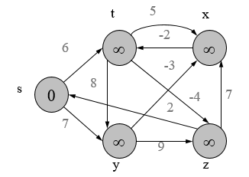

Slide 127
Huffman Coding
Huffman Coding is a famous Greedy Algorithm.
It is used for the lossless compression of data.
It uses variable length encoding.
It assigns variable length code to all the characters.
The code length of a character depends on how frequently it occurs in the given text.
The character which occurs most frequently gets the smallest code.
The character which occurs least frequently gets the largest code.
It is also known as Huffman Encoding.

Slide 128
Steps in Huffman Coding
There are two major steps in Huffman Coding-
Building a Huffman Tree from the input characters.
Assigning code to the characters by traversing the Huffman Tree.

Slide 129
Huffman Tree
Step-01:
Create a leaf node for each character of the text.
Leaf node of a character contains the occurring frequency of that character.
Step-02:
Arrange all the nodes in increasing order of their frequency value.
Step-03:
Considering the first two nodes having minimum frequency,
Create a new internal node.
The frequency of this new node is the sum of frequency of those two nodes.
Make the first node as a left child and the other node as a right child of the newly created node.

Slide 130
Step-04
Keep repeating Step-02 and Step-03 until all the nodes form a single tree.
The tree finally obtained is the desired Huffman Tree.

Slide 131
Time Complexity
The time complexity analysis of Huffman Coding is as follows-
extractMin( ) is called 2 x (n-1) times if there are n nodes.
As extractMin( ) calls minHeapify( ), it takes O(logn) time.
Thus, Overall time complexity of Huffman Coding becomes O(nlogn).
Here, n is the number of unique characters in the given text.

Slide 132
PRACTICE PROBLEM
Q1 A file contains the following characters with the frequencies as shown. If Huffman Coding is used for data compression, determine-
Huffman Code for each character
Average code length
Length of Huffman encoded message (in bits)

Slide 133
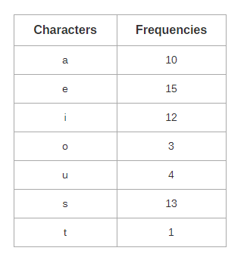

Slide 134
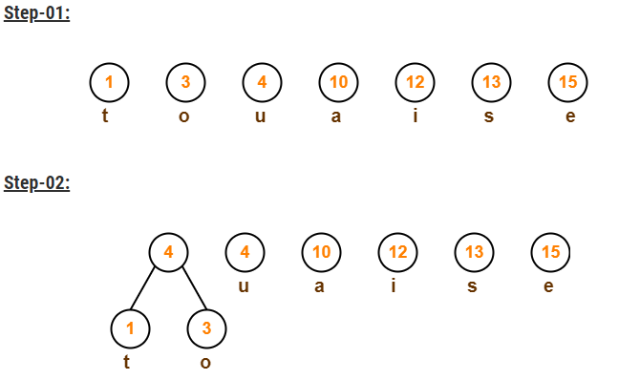
Solution

Slide 135
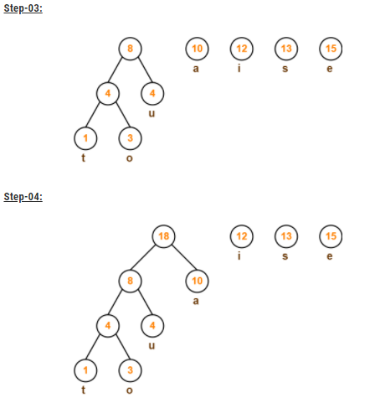

Slide 136
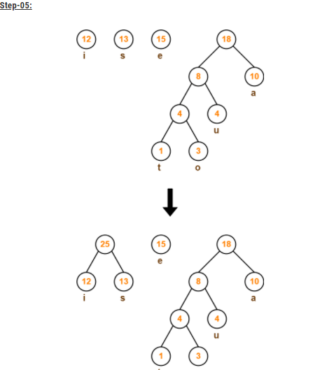

Slide 137
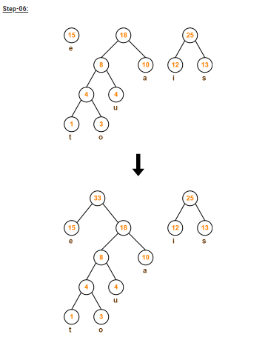

Slide 138
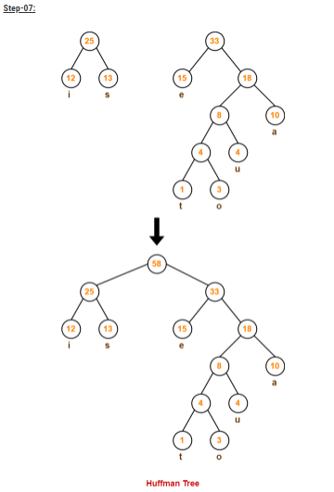

Slide 139
Now,
We assign weight to all the edges of the constructed Huffman Tree.
Let us assign weight ‘0’ to the left edges and weight ‘1’ to the right edges or wise versa.

Slide 140
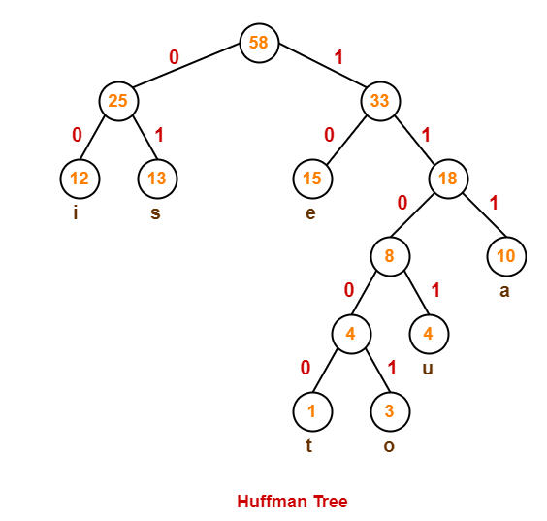

Slide 141
1. Huffman Code For Characters-
To write Huffman Code for any character, traverse the Huffman Tree from root node to the leaf node of that character.
Following this rule, the Huffman Code for each character is-
a = 111
e = 10
i = 00
o = 11001
u = 1101
s = 01
t = 11000
From here, we can observe-
Characters occurring less frequently in the text are assigned the larger code.
Characters occurring more frequently in the text are assigned the smaller code.

Slide 142
Average Code Length
Average code length = ∑ ( frequencyi x code lengthi ) / ∑ ( frequencyi )
{ (10 x 3) + (15 x 2) + (12 x 2) + (3 x 5) + (4 x 4) + (13 x 2) + (1 x 5) } / (10 + 15 + 12 + 3 + 4 + 13 + 1)
= 2.52

Slide 143
Length of Huffman Encoded Message
Total number of characters in the message x Average code length per character
58 x 2.52=146

